Slide 1


Interpretable Sparse Modeling of Longitudinal Signals via Critical-Range Rectification and Anytime Rule Compression
Achieving Explainability while Minimizing Computational Cost
Committee Members: Dr. Jiangwen Sun Dr. Mohammed Zubair Dr. Yoahang Li Dr. Yet Nguyen
Jason Orender
Department of Computer Science
Date 2/23/2026
Notes:
Many longitudinal problems are driven by threshold-and-lag behavior, but continuous high-dimensional signals are strongly correlated and make sparse selection unstable. I show that critical-range binarization/rectification improves recoverability and interpretability for L1 models in a variety of settings and applications, then I show that I can compress the resulting sparse models in many cases into compact rule lists with an anytime procedure, finally delivering the full workflow as a reproducible python package (CUTLASS).

Slide 2
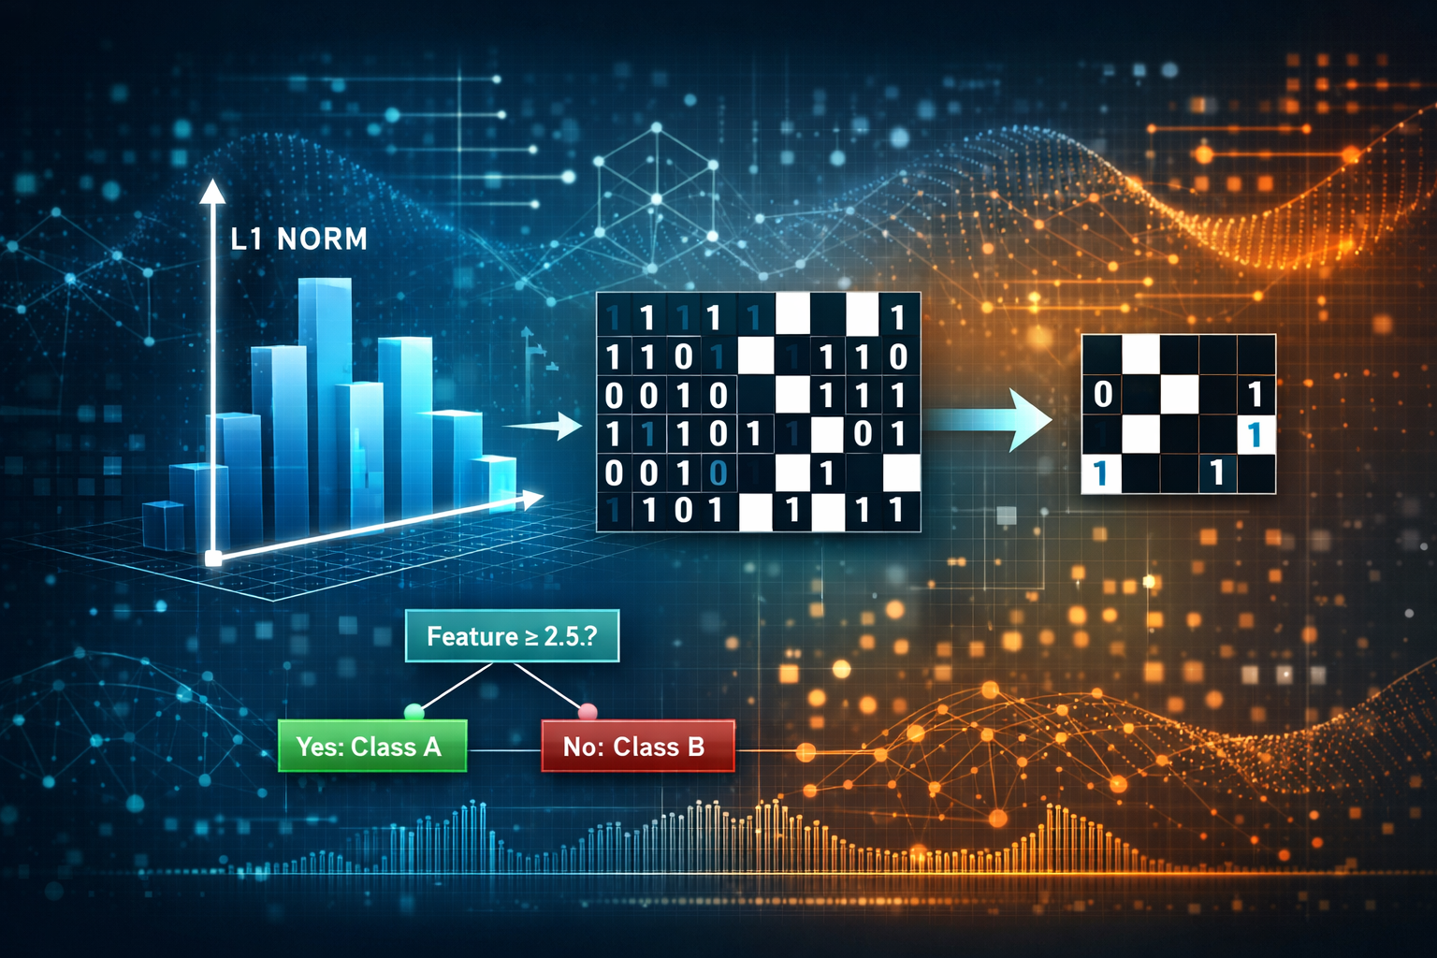

Overview
Thesis:
Critical-range rectification makes sparse longitudinal modeling more reliable and interpretable; anytime rule compression makes it usable.
01.
Background
Discuss the core problem and knowledge gap
02.
Research Questions
Define the questions that will address the knowledge gap: RQ1: Can critical-range binarization produce a stable sparse baseline with reliable feature attribution?
RQ2: Why does binarization work, and can the backbone be generalized? RQ3: Can the solution be compressed into a set of logical rules?
03.
Contributions
Summarize the contributions, timeline, and future work

Slide 3

01.
Background
The core problem and knowledge gap.

Slide 4


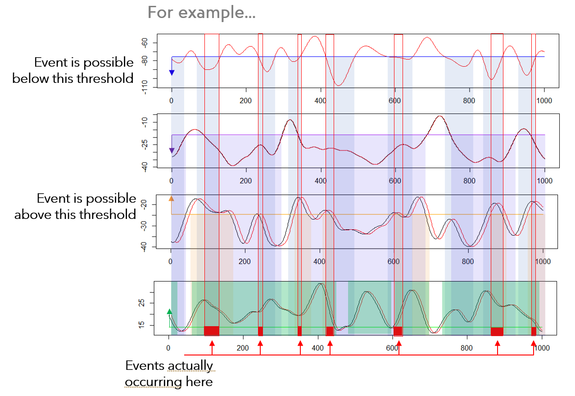
Core Problem
Two tensions:
correlation + high dimension → unstable sparse selection
interpretability demands rules, not hundreds of coefficients.
Real World
Longitudinal sensor/clinical/industrial signals often reflect threshold behavior and lagged dependencies, which complicates creation of interpretable models.

Slide 5


Knowledge Gap
Accurate, Interpretable, Sparse, Efficient
Existing sparse methods become unstable under correlated lag features, existing rule learners are costly, and black boxes aren’t usable in constrained compute environments or in areas where interpretability is more important than simple accuracy.

Slide 6
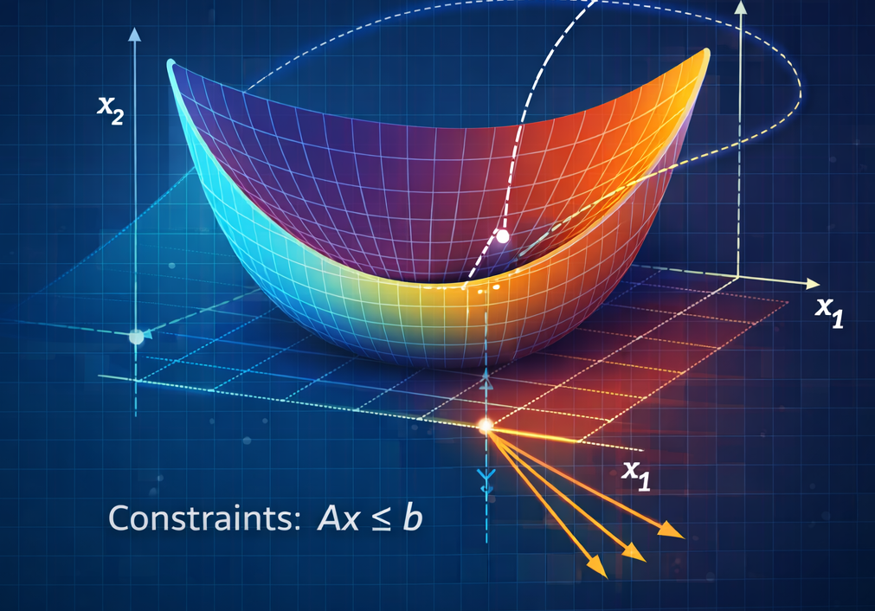
Other Solutions
Group and structured sparsity
These impose some kind of structure on the coefficients, preserve domain groupings, and stabilize estimation, but remain sensitive to near singular covariance.
There are several competing solutions to these problems, but they each have shortcomings that limit their usefulness. Note that deep learning solutions were as a rule not considered as “competing” methods this work focuses on inherently interpretable sparse models with explicit feature attribution under constrained compute.
Rank based LASSO
These can be advantageous in specific regimes but ultimately leave the original covariance geometry intact, affecting both sparsity and accuracy.
Quadratic programming and logic rules
Wrapper methods
These are perhaps the closest and produce a similar result but are computationally intensive and tend to focus on pairwise testing and combinatorial rule searches.
These pragmatically prune the data using less transparent heuristics and complex dependencies, often making the answers difficult to understand.

Slide 7
02.
Approach/Research Questions
The main thrust of the work.

Slide 8
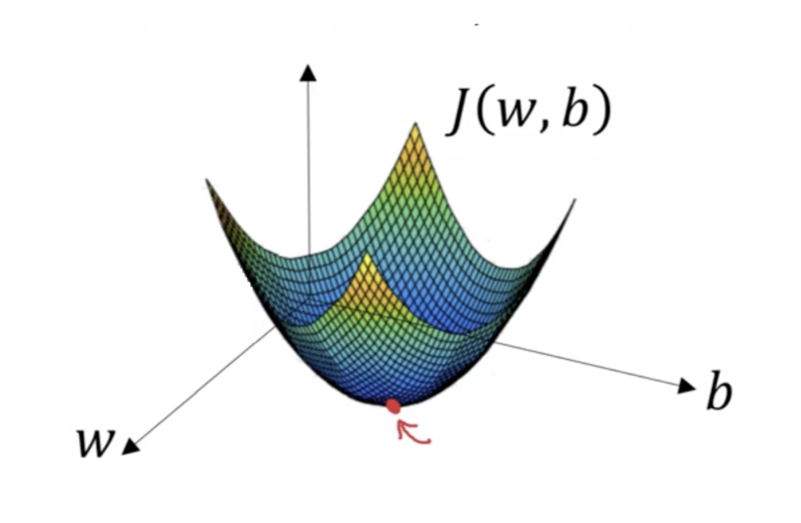
Proposed Solution (end-to-end)
E
H
P
W
Raw Coefficient
Features (A-Z)
E + H + P + W
Rectify
Fit Sparse Model
Compress
Use a rectification scheme to reduce the irrelevant and enhance the relevant information to enhance contrast.
Use an optimized model fitting technique to converge on a solution via gradient descent.
Convert the sparse coefficients into an anytime rule-based model which is easy to understand and apply.

Slide 9

Critical Range
Definition
A critical range describes a condition in which an event has a non-zero chance of occurring. In its simplest manifestation for independent variables, it is a min and max describing all times in which that event has ever occurred, but may be a more complex association if variables are not independent. In short, rectification turns continuous, correlated signals into logical indicators.
-1
Not within the critical range
(-1)
(+1)
+1
Within the critical range
(+1)
(+1)
(+1)
(+1)
(+1)
(+1)
A binarized matrix of identical proportions to the original is constructed, but with {-1, +1} replacing feature values
(-1)
Matrix
(-1)
(-1)
(-1)
(-1)
(-1)
(-1)
(-1)
(-1)
A response vector is constructed in which the event either occurs or does not occur { 1, 0 }
Outcome
** Ranges learned on training folds only

Slide 10
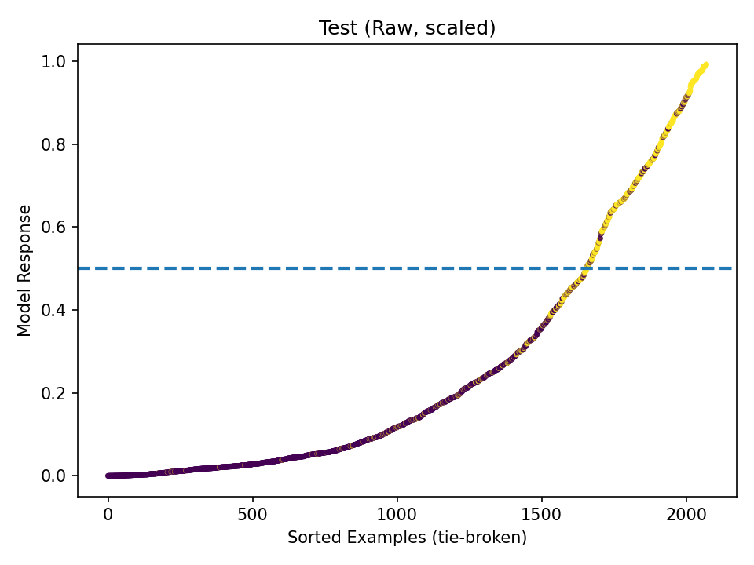
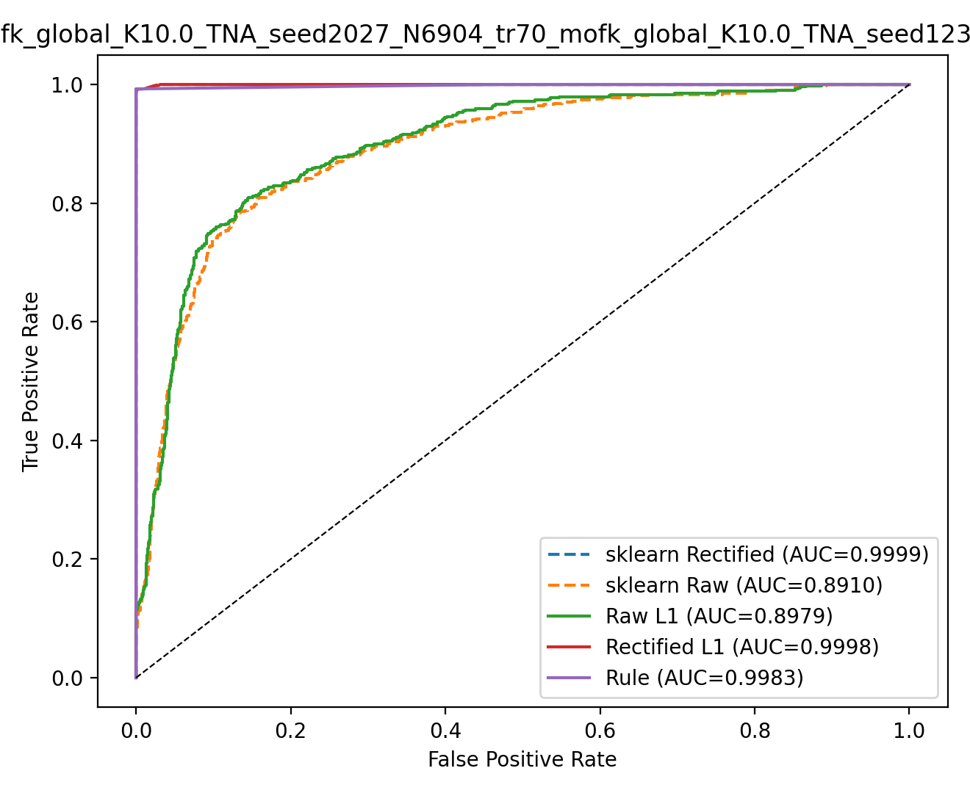
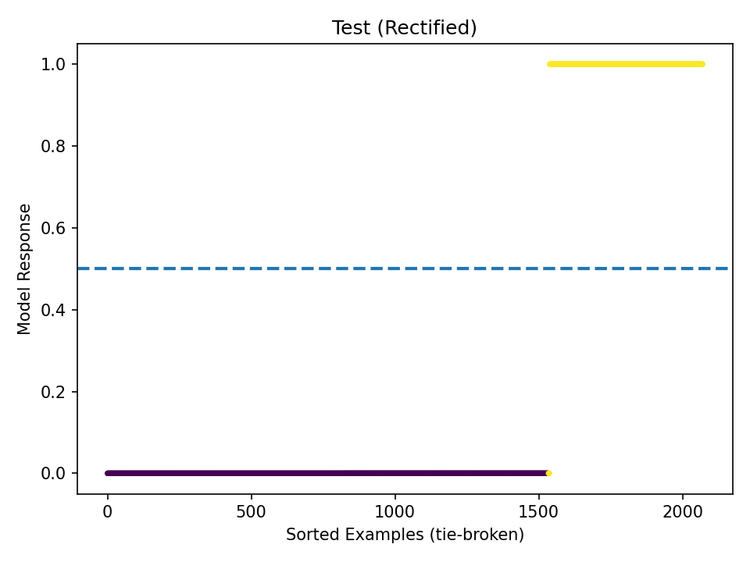
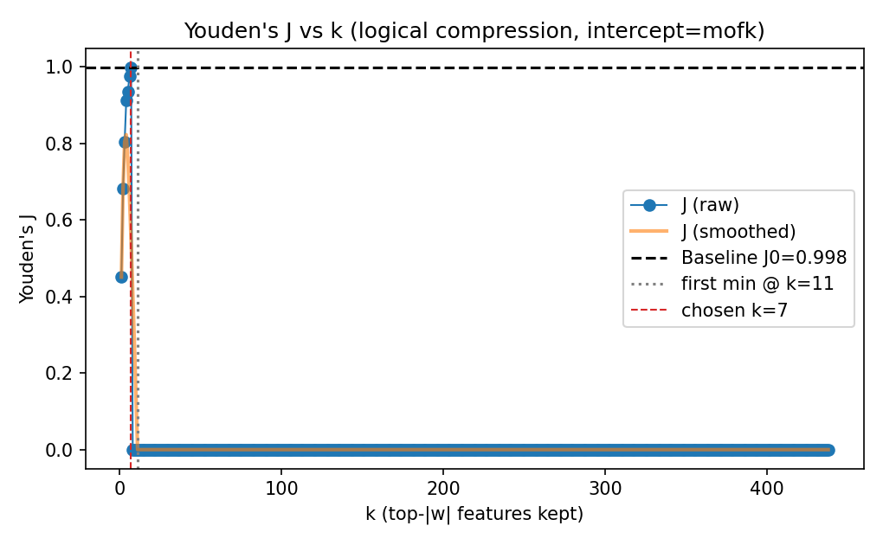
Measuring Success
Predictive and Interpretable
The goal of this work is to create a system for modeling that produces easily interpretable rules but still describes the phenomenon as well or nearly as well as the best alternate solution. The metrics we used are selected to be as descriptive and non-biased as possible:
Performance:
Area Under the ROC Curve (AUC)
Youden’s J-Index (notable for its use in imbalanced data sets)
Interpretability:
Number of Features / Rules (minimized)
Efficiency:
Training / Inference Runtime

Slide 11
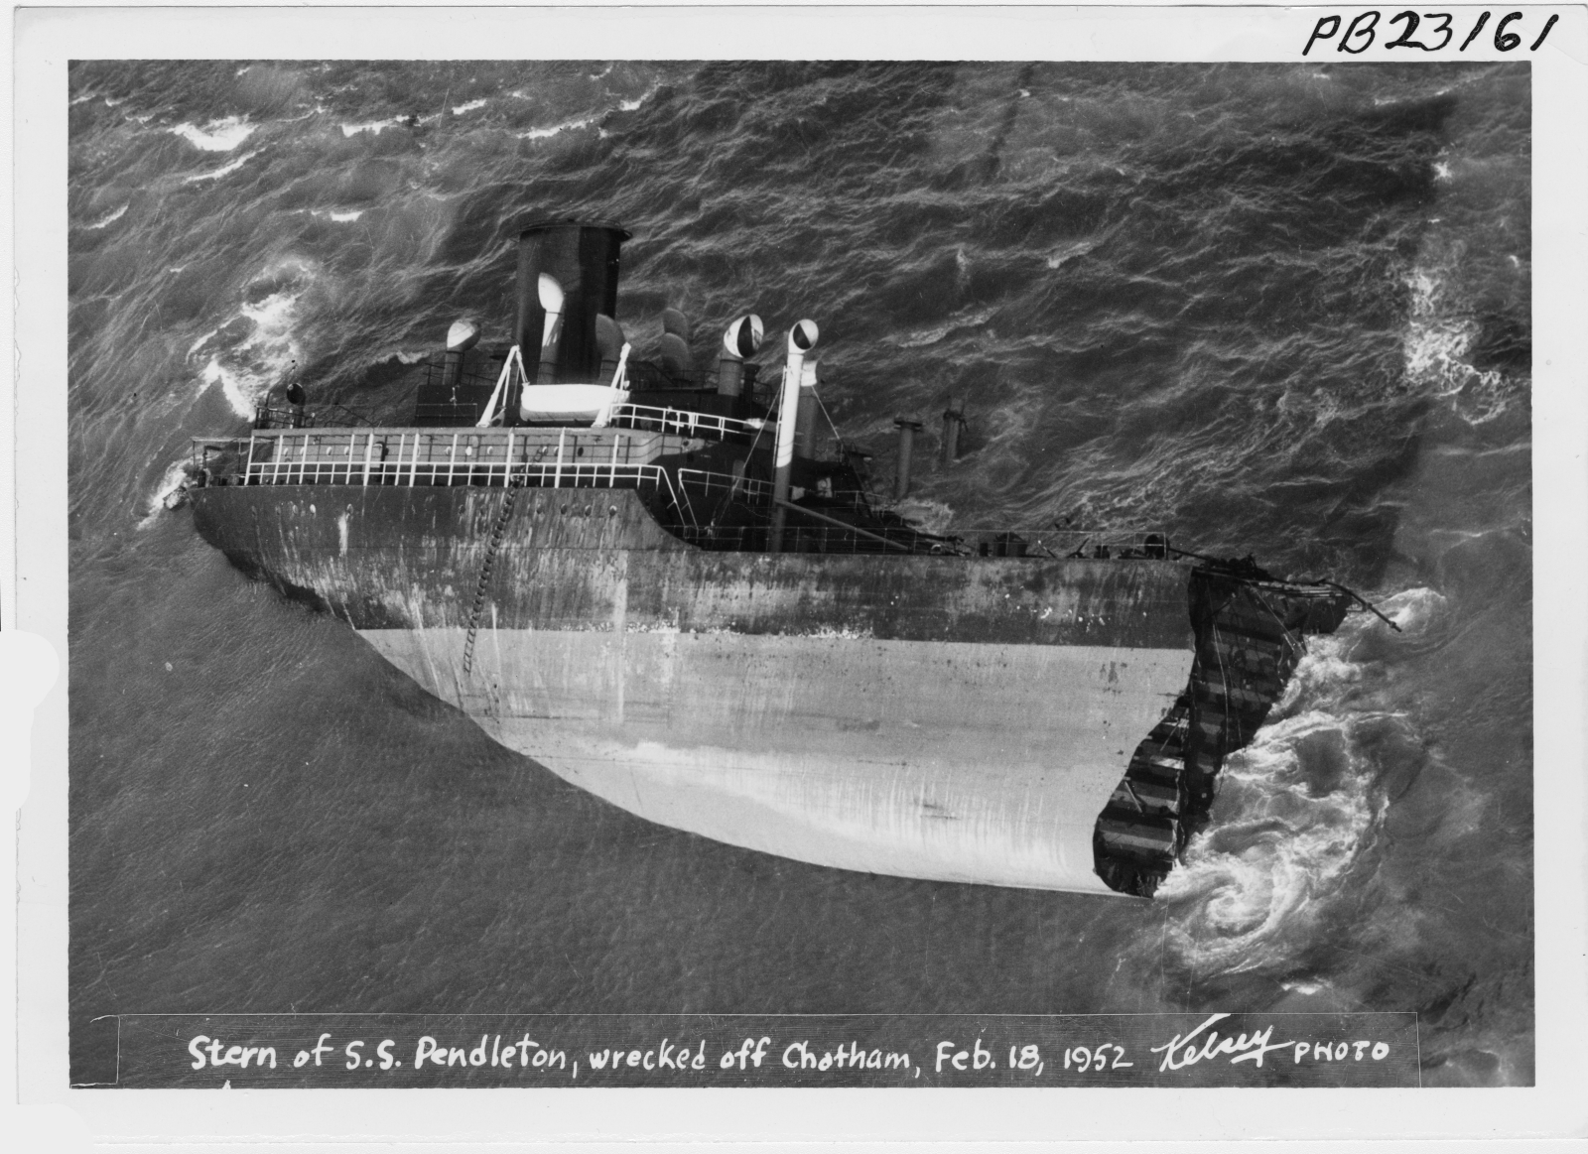
Research Questions
Motivation
Selecting relevant features in high-dimensional, strongly correlated longitudinal data is challenging when go/no-go thresholds and lags drive outcomes. Many physical phenomena (e.g. brittle fracture) and psychological outcomes are governed by such rules. We use binarization to map continuous measurements to binary indicators defined by critical ranges, simplifying correlations and stabilizing sparse model fitting. This motivation begs the following research questions:
RQ1
Can critical-range binarization produce a stable sparse baseline with reliable feature attribution?
RQ2
Why does binarization work, and can the backbone be generalized?
RQ3
Can the solution be compressed into a set of logical rules?

Slide 12
02a.
Research Question #1
Can critical-range binarization produce a stable sparse baseline with reliable feature attribution?

Slide 13
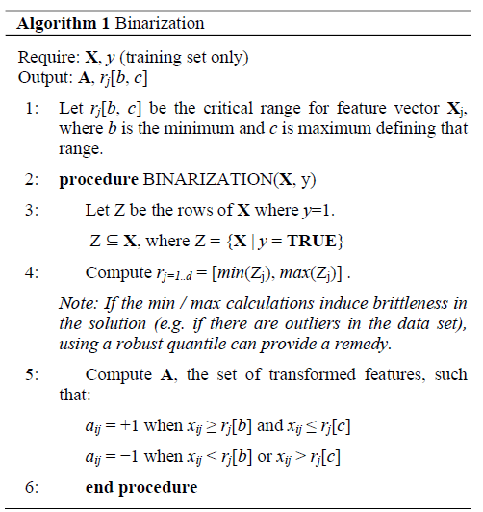
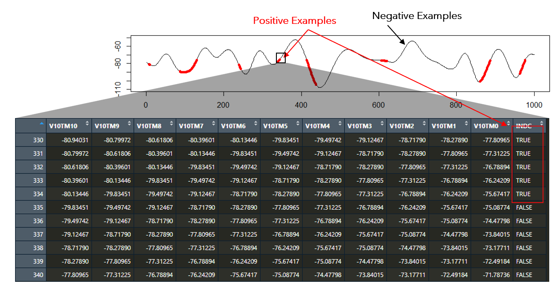
RQ1: Rectification Step
Collect and Flatten Longitudinal Data
Critical Range Determination
Lagged examples are collected for each event with each column of data offset by one time step for each measurement. This is the origin of the problem of highly correlated measurements.
All measurements taken when the response vector is “TRUE” are by definition within the critical range.

Slide 14
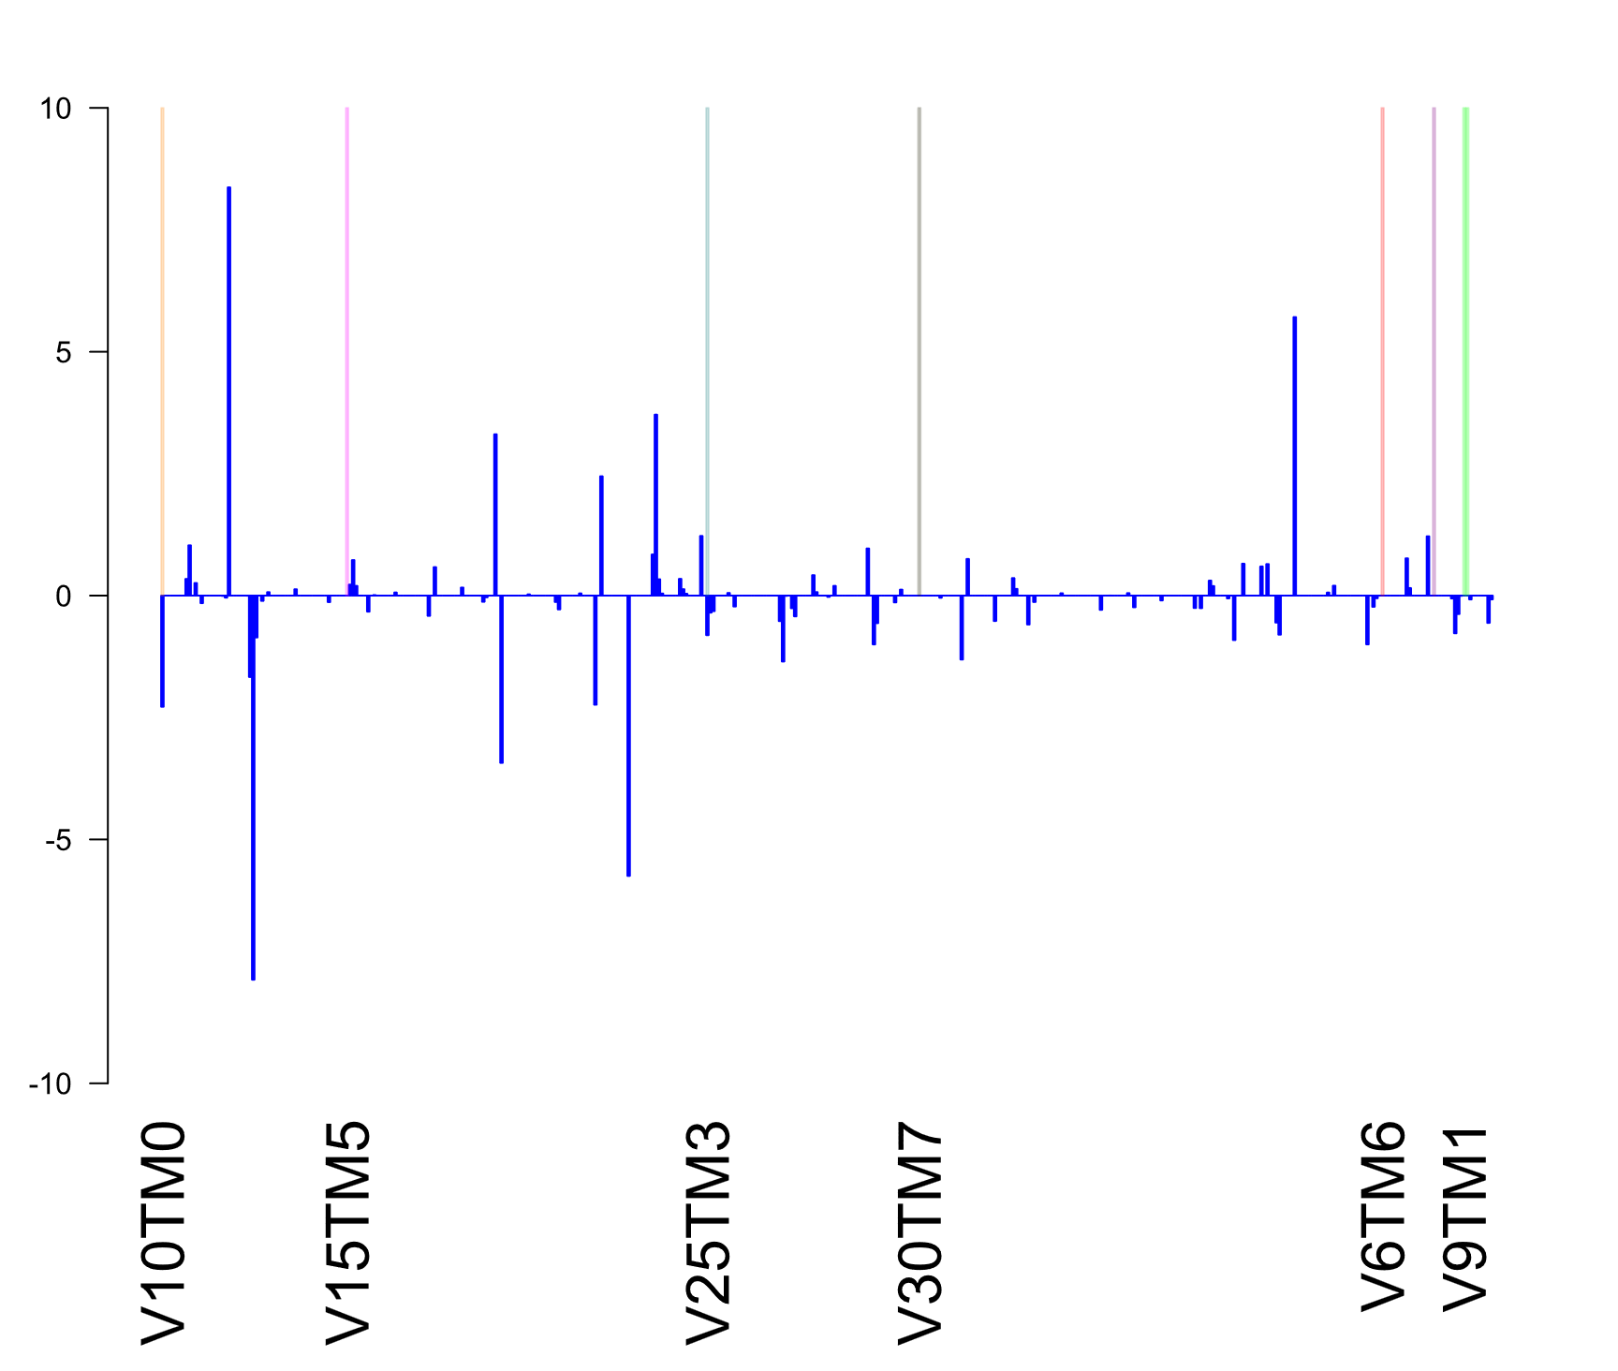
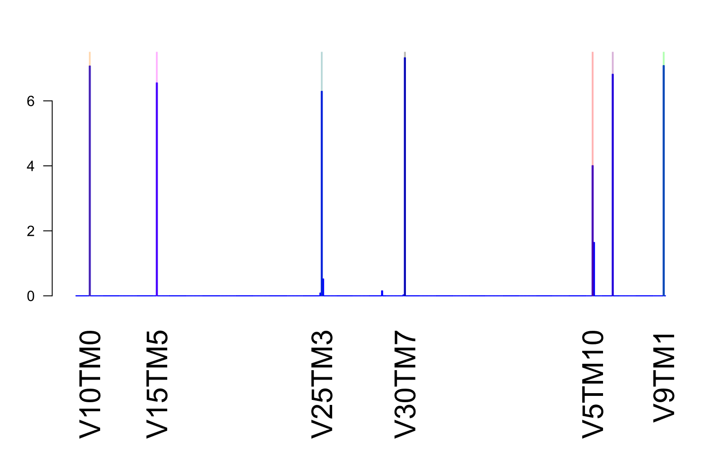
RQ1: Synthetic Data
Method | Status | Rel Execution Time | Youdens J-Index | F1 Score
LASSO | Transformed | 1.00 | 0.975 | 0.988
 | Un-Transformed | 1.83 | 0.753 | 0.804
Random Forest | Transformed | 12.5 | 0.980 | 0.990
 | Un-Transformed | 43.0 | 0.913 | 0.947
Group LASSO | Transformed | 24.5 | 0.689 | 0.558
 | Un-Transformed | 53.5 | 0.624 | 0.459
Coefficient Values
Compare Coefficients between Transformed vs. Untransformed Data
Features
Simply performing the critical range transformation on the synthetic input data showed remarkable adherence to the known relevant feature selection. Synthetic data was used first to compare actual results with known relevant features using complete data.

Slide 15
RQ1: Quadratic Programming Comparison
Using the method pioneered by Katrutsa and Strijov
Note that this gives coefficient values for “importance” but does not produce a model to measure other metrics (e.g. AUC, Youden’s J-Index, F1, etc.)
Many of the importance values came close to identifying the correct variables, but in many cases identified the wrong time-step.
The data is the same between last slide and this one.
The closest parallel method
In addition to being imprecise with respect to the specific relevant variables and time-steps, the computational intensity of that method was far in excess of the method
described in this work. The slowdown was variable, but the Katrutsa and Strijov method was generally about 100 to 200 times slower than the combined time requirement of the data transformation and LASSO fit together.

Slide 16
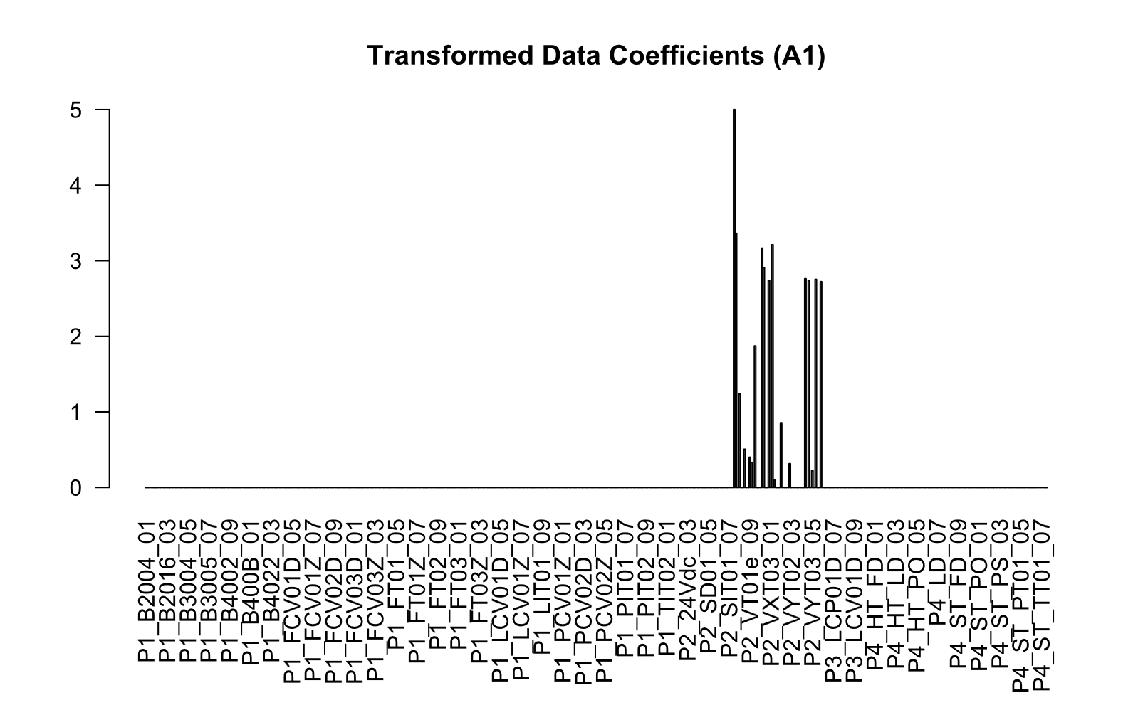
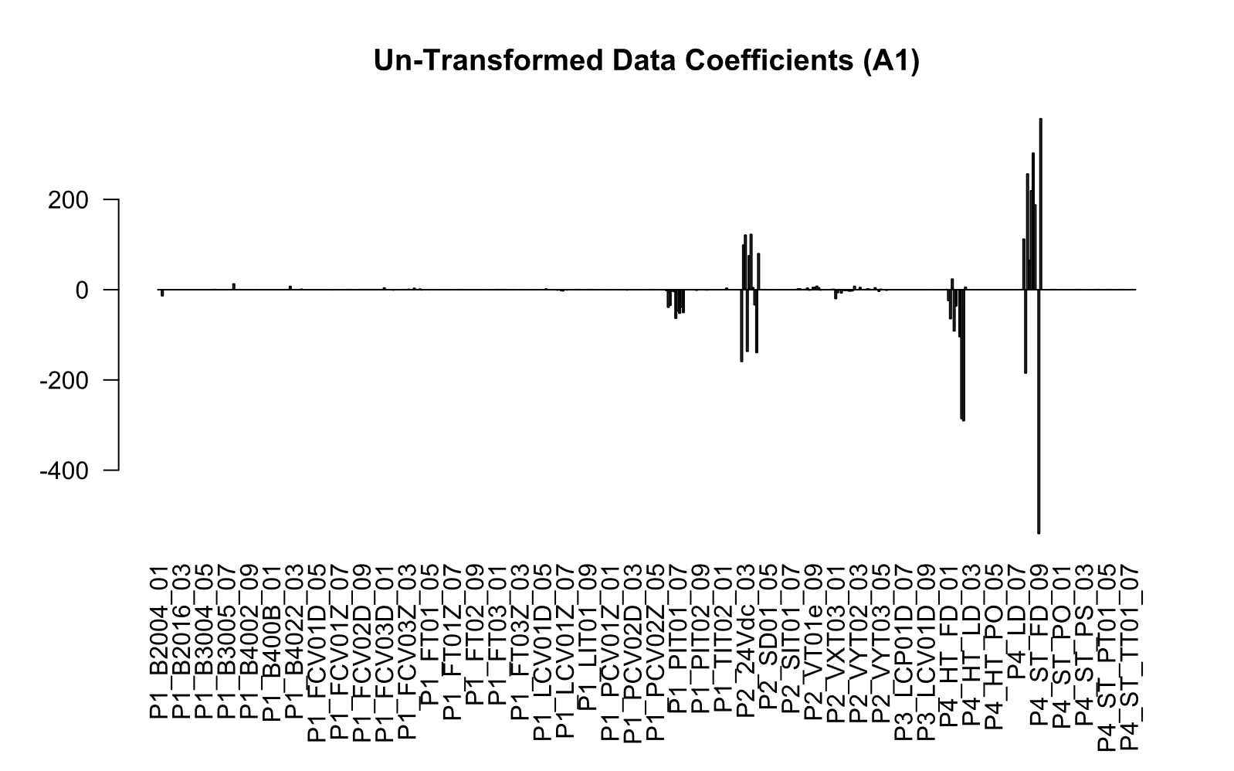
RQ1: Real World Data
HAI Transformed
Statistic | HAI (Transformed) | HAI (Un-Trans) | UNICEF (Transformed) | UNICEF (Un-Trans)
ACC | 0.987 | 0.939 | 0.902 | 0.963
AUC | 0.982 | 0.943 | 0.865 | 0.989
F1 | 0.987 | 0.942 | 0.894 | 0.958
Youden’s J-Index | 0.974 | 0.878 | 0.815 | 0.925
“P2” indicates
turbine instrument
readings
P1 Instruments
P2
P3
P4
Instrument Features
Compare Coefficients between Transformed vs. Untransformed Data
HAI Un-Transformed
The coefficients correctly identified the correct features (the turbine instrument) in this case and excluded other features which were not relevant. Note that while the basic metrics of the UNICEF data set were superior for the un-transformed data, the complexity of the solution was much greater (5 vs. 16 feature categories).

Slide 17
RQ1: Takeaway
What Remains:
The binarization method effectively shifts the frame of reference to boolean logic,
providing an alternative to traditional additive models. It leverages the LASSO algorithm
to identify optimal logical combinations with a sparse coefficient vector, useful
as a feature selection tool beyond just classification. It also identifies critical ranges
for continuous variables, offering additional insights to adjust variables and influence
studied processes. Any problems that can be formulated as binary classifications can
potentially benefit from this approach.
Why does this work mathematically?
What general insights can be gained from a mathematical description?
When does it generalize?
What are the drawbacks and when do they occur?
Bonus advantage
The binarization process also reduces computational demands compared to untransformed data. Model fitting with transformed data is nearly twice as fast, even including transformation time. The linear time transformation supports parallelism for large datasets and potentially could benefit from faster integer math. Thus, transforming data prior to fitting can also improve efficiency.

Slide 18
02b.
Research Question #2
Why does binarization work, and can the backbone be generalized?

Slide 19
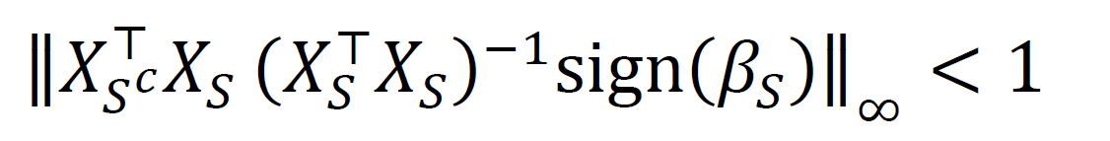
RQ2: Irrepresentable Condition (IC)
We are attempting to prove that the probability of the following relationship holding true:
Based on the work of Zhao and Yu in 2006, which proved that if we can satisfy the IC relationship, there is a substantially improved probability of recovering the true support for a dataset.
We will use the arcsin relation as a tractable proof‑of‑concept (PoC) to show that in the case of zero-based thresholds binarization increases the probability of satisfying the IC.
High collinearity among raw, lag‑expanded features often violates the IC, yielding dense or unstable selections, hence the focus in this work on longitudinal data.
is greater if binarization is used to transform the data set.
A Tractable Proof-of-Concept (POC)
While nonzero thresholds obey a related but more intricate mapping, the full proof of such a relationship would be far more complex and would not be necessary to show the broad strokes of why binarization helps. However, such an effort might be beneficial for teasing out additional applications or how the method might be useful in the future. As a result, further work along these lines is recommended going forward.

Slide 20
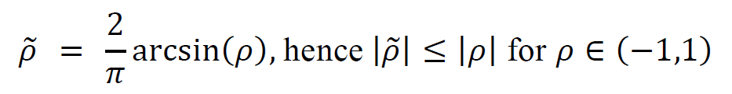
RQ2: The Arcsin Relation
The bivariate normal orthant probability identity, 𝑃(𝑋 > 0, 𝑌 > 0) = 1⁄4 + 1⁄2𝜋 arcsin(𝜌) implies the following closed-form mapping:
For standardized, jointly normal (𝑋, 𝑌) with correlation 𝜌 and binarized 𝑋.
The tilde (“~”) is used to distinguish binarized data from its original continuous counterpart, where in this case all feature values greater than 0 are coded as +1 and all feature values that are less than or equal to zero are coded as -1.
Under joint normality and zero-threshold sign binarization, this result shows that when binarized, all pairwise correlations must be less than or equal to their original, never greater.
In fact, equality occurs only at 𝜌∈{−1,0,1}, due to the arcsin relation being strictly convex on (0,1) and strictly concave on (-1,0).
A Tractable Proof-of-Concept (POC)
While nonzero thresholds obey a related but more intricate mapping, the full proof of such a relationship would be far more complex and would not be necessary to show the broad strokes of why binarization helps. However, such an effort might be beneficial for teasing out additional applications or how the method might be useful in the future. As a result, further work along these lines is recommended going forward.
Notes:
In the Gaussian/elliptical case, the correlation structure induced by sign-binarization is exactly Kendall’s tau. Thus, sign-binarization (as presented) is effectively converting linear dependence into monotone / ordinal dependence. This also might imply less sensitivity to outliers or heavy tails, making the solutions more robust. However, we have not studied these aspects, yet.

Slide 21
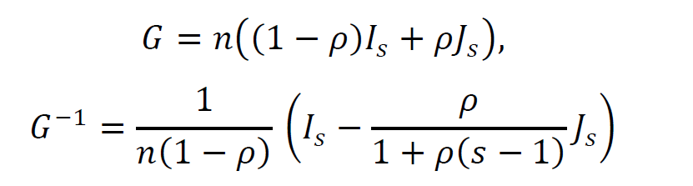
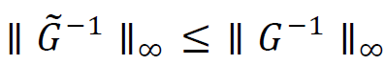
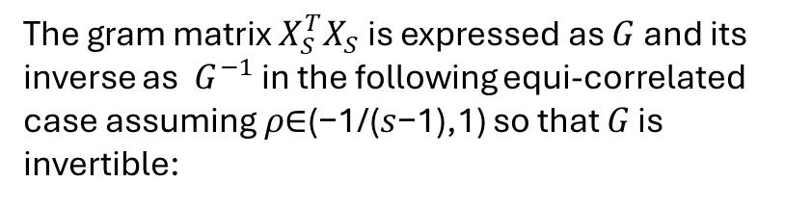
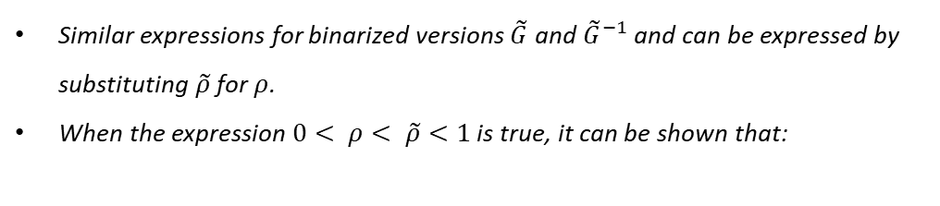
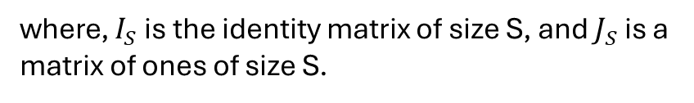
RQ2: Gram Matrix Bounds
The gram matrix $X_{S}^{T}X_{S}$ is expressed as $G$ and its inverse as $G^{−1}$ in the following equi-correlated case assuming 𝜌∈(−1/(𝑠−1),1) so that 𝐺 is invertible:
Similar expressions for binarized versions $\tilde{G}$ and ${\tilde{G}}^{−1}$ and can be expressed by substituting $\tilde{ρ}$ for $ρ$.
When the expression $0< ρ< \tilde{ρ}<1$ is true, it can be shown that:
Thus, binarization will consistently emphasize positive correlation relationships by reducing the infinity norm of the inverse gram matrix. Recall that this is the second term in the IC:
where, $I_{S}$ is the identity matrix of size S, and $J_{S}$ is a matrix of ones of size S.
A Tractable Proof-of-Concept (POC)
While nonzero thresholds obey a related but more intricate mapping, the full proof of such a relationship would be far more complex and would not be necessary to show the broad strokes of why binarization helps. However, such an effort might be beneficial for teasing out additional applications or how the method might be useful in the future. As a result, further work along these lines is recommended going forward.
Notes:
Uses the Sherman-Morrisson-Woodbury formula for the inverse of a matrix.
Under symmetric binarization, the binarized Gram matrix remains equicorrelated with effective correlation $\tilde{ρ}$.
The resulting inequality follows from the closed-form row-sum expression of $G^{−1}$under equicorrelation.

Slide 22
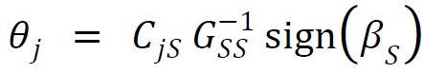
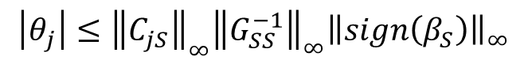
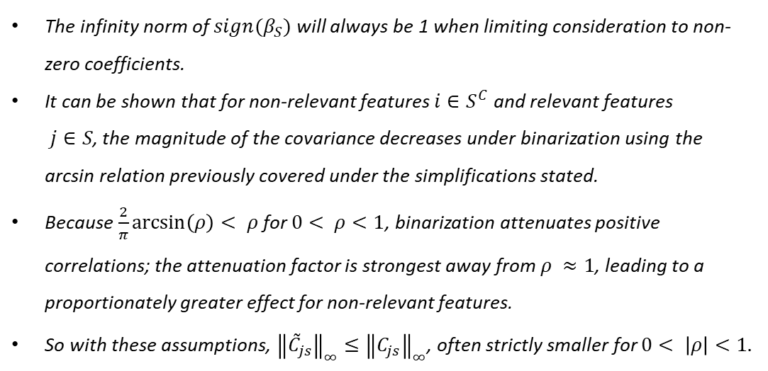
RQ2: Parsing the Results
Taking the original IC expression:
The infinity norm of $sign(β_{S})$ will always be 1 when limiting consideration to non-zero coefficients.
It can be shown that for non-relevant features $i∈S^{C}$ and relevant features $j∈S$, the magnitude of the covariance decreases under binarization using the arcsin relation previously covered under the simplifications stated.
Because $\frac{2}{π}\arcsin\left(ρ\right)< ρ$ for $0< ρ<1$, binarization attenuates positive correlations; the attenuation factor is strongest away from $ρ ≈1$, leading to a proportionately greater effect for non-relevant features.
So with these assumptions, ${\left\|{\tilde{C}}_{js}\right\|}_{∞}≤{\left\|C_{js}\right\|}_{∞}$, often strictly smaller for $0< \left|ρ\right|<1.$
and defining a similar form:
then applying the submultiplicative property of induced norms:
$$\left|θ_{j}\right|≤{\left\|C_{jS}\right\|}_{∞}{\left\|G_{SS}^{−1}\right\|}_{∞}{\left\|sign\left(β_{S}\right)\right\|}_{∞}$$
A Tractable Proof-of-Concept (POC)
While nonzero thresholds obey a related but more intricate mapping, the full proof of such a relationship would be far more complex and would not be necessary to show the broad strokes of why binarization helps. However, such an effort might be beneficial for teasing out additional applications or how the method might be useful in the future. As a result, further work along these lines is recommended going forward.
Notes:
Uses the Sherman-Morrisson-Woodbury formula for the inverse of a matrix.
Under symmetric binarization, the binarized Gram matrix remains equicorrelated with effective correlation $\tilde{ρ}$.
The resulting inequality follows from the closed-form row-sum expression of $G^{−1}$under equicorrelation.

Slide 23
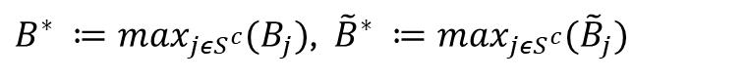
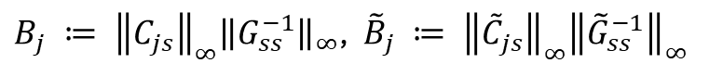
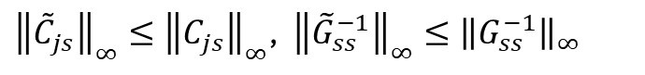
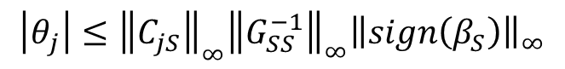
RQ2: Putting the Pieces Together
Since:
Thus, under the stated assumptions:
$$\left|θ_{j}\right|≤{\left\|C_{jS}\right\|}_{∞}{\left\|G_{SS}^{−1}\right\|}_{∞}{\left\|sign\left(β_{S}\right)\right\|}_{∞}$$
$$\operatorname{Pr}\left({\tilde{B}}^{∗}<1\right) ≥ \operatorname{Pr}\left(B^{∗}<1\right)$$
and:
The lemmas isolate why binarization helps:
pairwise contraction keeps off‑diagonals from saturating
better conditioning bounds inverse norms
Smaller off‑support covariances reduce the IC term.
Together these raise the chance of correct support recovery and promote sparse, stable selections.
${\left\|{\tilde{C}}_{js}\right\|}_{∞}≤{\left\|C_{js}\right\|}_{∞}$, ${\left\|{\tilde{G}}_{ss}^{−1}\right\|}_{∞}≤{\left\|G_{ss}^{−1}\right\|}_{∞}$
we define:
${B_{j} ≔ \left\|C_{js}\right\|}_{∞}{\left\|G_{ss}^{−1}\right\|}_{∞}$, ${{\tilde{B}}_{j} ≔ \left\|{\tilde{C}}_{js}\right\|}_{∞}{\left\|{\tilde{G}}_{ss}^{−1}\right\|}_{∞}$
$B^{∗} ≔\max_{jεS^{c}}(B_{j})$, ${\tilde{B}}^{∗} ≔\max_{jεS^{c}}({\tilde{B}}_{j})$
A Tractable Proof-of-Concept (POC)
While nonzero thresholds obey a related but more intricate mapping, the full proof of such a relationship would be far more complex and would not be necessary to show the broad strokes of why binarization helps. However, such an effort might be beneficial for teasing out additional applications or how the method might be useful in the future. As a result, further work along these lines is recommended going forward.
Notes:
Uses the Sherman-Morrisson-Woodbury formula for the inverse of a matrix.
Under symmetric binarization, the binarized Gram matrix remains equicorrelated with effective correlation $\tilde{ρ}$.
The resulting inequality follows from the closed-form row-sum expression of $G^{−1}$under equicorrelation.

Slide 24
02c.
Research Question #3
Can the solution be compressed into a set of logical rules?

Slide 25
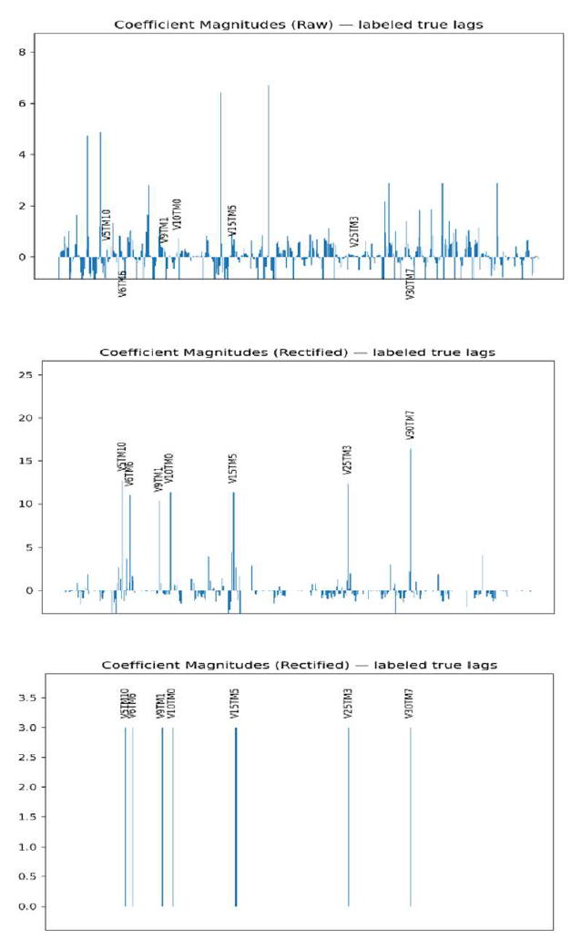
RQ3: Rule Compression
L1-regularized logistic models provide:
Sparsity
Computational simplicity
But there are still potentially large numbers of small magnitude weights that obscure underlying logic. The example to the right shows the value that each step in the process provides.
Rectification focuses the model on the appropriate features
Rule compression cleans the result and produces a logical model
“Logic Polishing”
We will use the term “logic polishing” to describe the process of taking the focused results of the L1-logistic and cleaning up the smaller magnitude coefficients by forcing the coefficients to be either a specific large value or zero. The specific value chosen can be adjusted, but experiments have shown that there is very little difference in the outcome as long as the chosen coefficient is sufficiently larger than the noisy coefficients we are attempting to force to zero.
Notes:
In the Gaussian/elliptical case, the correlation structure induced by sign-binarization is exactly Kendall’s tau. Thus, sign-binarization (as presented) is effectively converting linear dependence into monotone / ordinal dependence. This also might imply less sensitivity to outliers or heavy tails, making the solutions more robust. However, we have not studied these aspects, yet.

Slide 26
RQ3: Results
The Youden’s J vs K plot shows the number of features required to achieve the specific result.
The procedure shows a clear progression, which will allow the model to stop once the desired metric value has been reached.
Adding more features than is required forces the result to zero in this case since irrelevant features will not be in sync with the other features (a hallmark of spurious correlators).
*These models also passed the “Two One-Sided Tests” (TOST) criteria to consider these results statistically equivalent with 90% CI within ±0.01AUC.
Paired t-test AUC P-value comparison
Run | Binarized (new) | Rule-based model | Binarized (sk-learn) | Raw (sk-learn)
Binarized (new) | NA | 1.6E-6* | 1.5E-6* | 7.3E-8
Rule-based model | 1.6E-6* | NA | 9.7E-10* | 6.6E-7
Binarized (sk-learn) | 1.5E-6* | 9.7E-10* | NA | 7.7E-9
Raw (sk-learn) | 7.3E-8 | 6.6E-7 | 7.7E-9 | NA
Notes:
In the Gaussian/elliptical case, the correlation structure induced by sign-binarization is exactly Kendall’s tau. Thus, sign-binarization (as presented) is effectively converting linear dependence into monotone / ordinal dependence. This also might imply less sensitivity to outliers or heavy tails, making the solutions more robust. However, we have not studied these aspects, yet.

Slide 27
03.
Contributions
Summarize the contributions, timeline, and future work

Slide 28
Contributions
RQ1
RQ2
RQ3
Critical-range rectification yields more reliable feature/lag attribution in longitudinal, correlated settings (synthetic + real-world).
Often improves interpretability and efficiency (fewer feature categories; faster fits).
Proof-of-concept shows binarization can increase the probability of satisfying IC under tractable assumptions.
Key mechanism: correlation contraction + improved conditioning → smaller off-support influence.
“Logic polishing” compresses sparse models into compact rule forms without materially degrading AUC / J (equivalence framing).
Anytime behavior: stop once desired J reached (complexity-performance tradeoff).
Outcome
The final result of the analysis will be an interpretable sparse baseline, theoretical justification, and usable rule model with a reproducible implementation pathway.
Notes:
In the Gaussian/elliptical case, the correlation structure induced by sign-binarization is exactly Kendall’s tau. Thus, sign-binarization (as presented) is effectively converting linear dependence into monotone / ordinal dependence. This also might imply less sensitivity to outliers or heavy tails, making the solutions more robust. However, we have not studied these aspects, yet.

Slide 29
Conclusions
RQ1
RQ2
RQ3
The accumulated evidence supports a conditional positive conclusion for RQ1.
In threshold-and-lag aligned settings, critical-range rectification tends to improve support concentration, lag localization, and sparse-model usability under multicollinearity stress.
This work provides a proof-of-concept theoretical argument: in a tractable regime (zero-threshold sign binarization with explicit assumptions).
Dependence contraction can improve the likelihood of satisfying IC-related sparse-recovery conditions.
Theoretical contribution is mechanistic rather than universal.
Sparse rectified models can often be compressed into substantially smaller rule representations while preserving practical discrimination quality under predefined tolerance policies.
Directly addresses deployment requirements in settings where explanation, auditability, and compact decision logic are non-negotiable.
Positioning Relative to Prior Work
This work extends, rather than replaces, prior sparse and interpretable modeling literature. Relative to classical L1 and elastic-net families, the main difference is intervention point: representation is modified before sparse optimization. Relative to grouped and ordered penalties, this work emphasizes threshold logic and lag-attribution clarity in a longitudinal context. Relative to direct rule-learning approaches, it uses sparse convex fitting as a scalable front end and performs structured rule simplification afterward.

Slide 30
Future Work (Prospectus Plan)
Must Do
High‑leverage experiments
Stretch Goals
RQ1 expansion: add stability analysis (bootstrap / fold stability) and a unified evaluation harness across datasets (AUC/J/complexity/runtime).
RQ3 validation: “Anytime” tradeoff curves on at least one real dataset + sensitivity to K / intercept policy.
Non-independence extension: demonstrate a multivariate/ interaction-aware critical region on a focused case study.
Ablations: (i) rectification only, (ii) L1 only, (iii) rectification+L1, (iv) +polish.
RQ2 strengthening: extend beyond zero-threshold PoC toward non-zero thresholds / critical-range thresholds (scope-limited, not full generality).
Package/reproducibility release + documentation for repeatable experiments.
Feedback Requested
(1) which baselines matter most, (2) which real dataset/case study should be the flagship, (3) how far to push the RQ2 generalization beyond PoC.
Notes:
In the Gaussian/elliptical case, the correlation structure induced by sign-binarization is exactly Kendall’s tau. Thus, sign-binarization (as presented) is effectively converting linear dependence into monotone / ordinal dependence. This also might imply less sensitivity to outliers or heavy tails, making the solutions more robust. However, we have not studied these aspects, yet.

Slide 31

Timeline To Graduation
Dissertation Prospectus
Defense (23 Feb)
Defense (17 Jul)
D3 form
Submission (6 Mar)
Graduate
Assessment
Survey (30 Jun)
COS Review Package due (31 Jul)
Graduation (28 Aug)
Pro-Quest Account Creation (mid-June)
Dissertation due
to committee (3 Jul)
Pro-Quest Submission Deadline (21 Aug)
Graduation Application Deadline (28 Feb)
Register for Summer (31 Mar)
D3/D5 Due to
CS department (24 Jul)
Complete:
All coursework
D2 form (formation of committee) approved
D9 form (advancement to candidacy) approved
Graduation Application (online via LEO)

Slide 32
THANK YOU

